Slide 1

Lecture 1: Android Concepts
Topics: Framework, Components, Intent

Slide 2
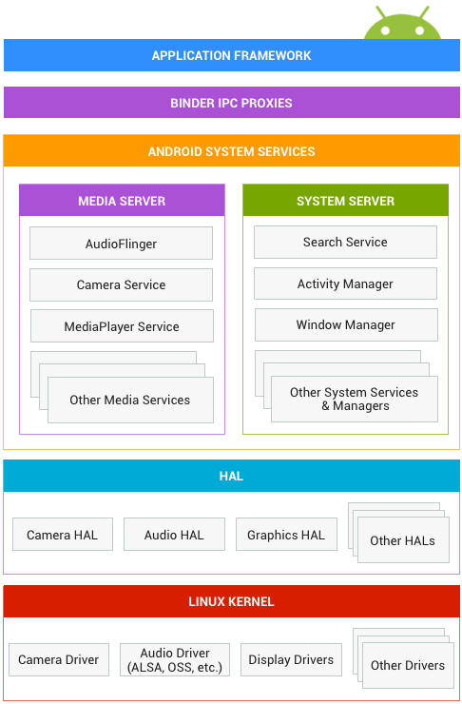
Android Interfaces and Architecture

Slide 3



Android Fundamentals
What kind of an OS is Android?
User ID1
User ID2
Android OS
A multi-user Linux system
(classroom.cs.unc.edu)
Notes:
Android OS is a multi-user Linux system.
Each app is like a different user (unique user ID).
Each app lives in its own security sandbox.
Every app runs in its own Linux process.
Android starts/terminates the process based on the need for an app's components to be executed.

Slide 4
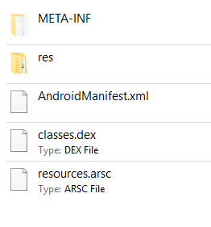
Android Fundamentals
What is an APK file?
Android SDK tools compile your java source files into .dex files, and then zip .dex file, project resources (images, layouts etc.) and the manifest file into an APK.
Unzip any android .apk and you will see these files inside it. You can find an .apk file inside: YourProject/app/build/outputs/apk
Note: You need to Build .apk from Android Studio at least once to see the apk folder in your laptop.

Slide 5
Android Fundamentals
What is ART?
ART = Android Runtime (it’s like Java Runtime)
Pros: Faster application execution.
Cons: Longer installation time, more storage requirement.
ART
DEX
dex2aot
native code
ART runtime
AOT (ahead of time) compilation
i.e. when an app is installed

Slide 6
Four Types of App Components
Activity
Service
Content Provider
Broadcast Receiver
Activity
Activity
Activity
Service
Content
Provider
Activity
Broadcast Receiver
Broadcast Receiver
Broadcast Receiver
An Example APP

Slide 7
App Components
Activity
Service
Content Provider
Broadcast Receiver
Activity
Your first app

Slide 8
The Manifest File
AndroidManifest.xml – we must declare all the app components (i.e., activity, service etc.) in this file.
This file also contains:
Permissions (e.g., location, storage etc.)
API Level (min and target)
HW/SW features used
Other API libraries

Slide 9
The Manifest File
<activity> elements for activities
<service> elements for services
<provider> elements for content providers
<receiver> elements for broadcast receivers
Activities, services, and content providers that you include in your source but do not declare in the manifest are not visible to the system and, consequently, can never run.
Broadcast receivers can be either declared in the manifest or created dynamically in code (as BroadcastReceiver objects) and registered with the system by calling registerReceiver().

Slide 10
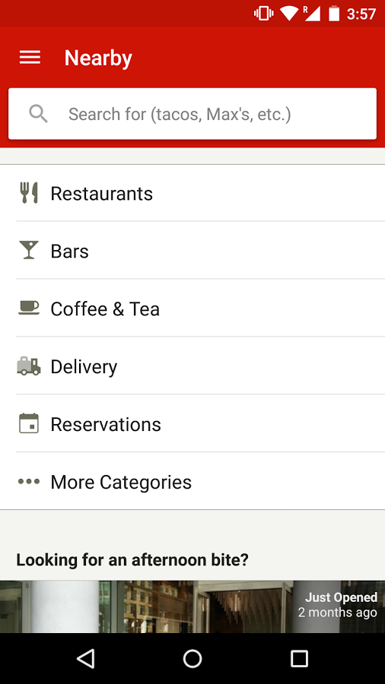
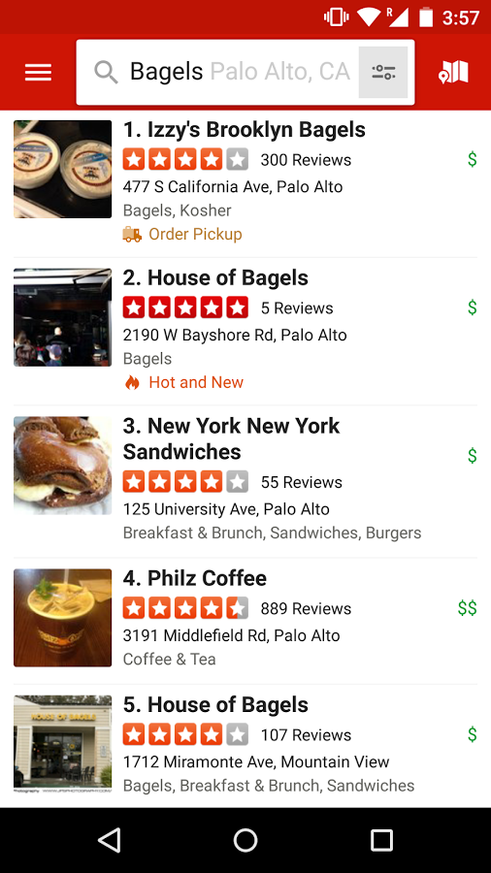
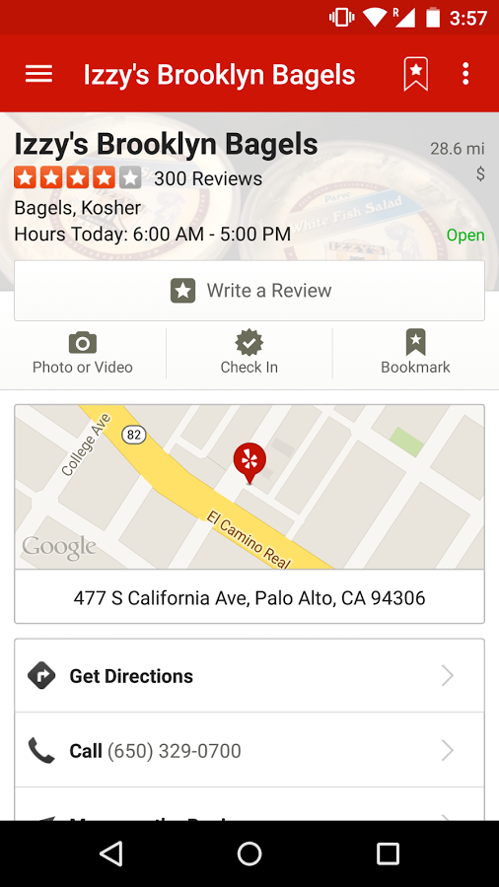
1. Activity
An activity represents a single screen with a user interface.

Slide 11
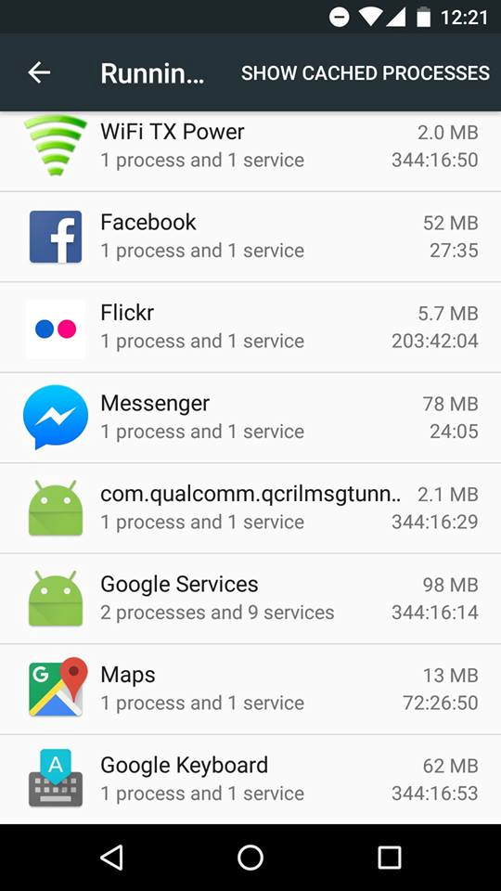
2. Service
Runs in the background to perform long running operations, or does some work for remote processes.
A service does not provide a user interface.
Yes, you can create your own services too.
Settings>Developer Options>Running Services

Slide 12
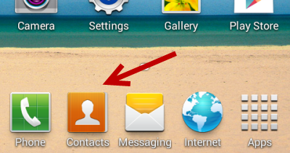
3. Content Provider
A content provider manages a shared set of app data.
Other apps can query or even modify the data.
You can store the data in the file system, an SQLite database, on the web, or any other persistent storage location your app can access.

Slide 13
4. Broadcast Receiver
A broadcast receiver is a component that responds to system-wide broadcast announcements.
Originate from the system—the battery is low, or a picture was captured.
Initiated by an App – download completed.
Broadcast receivers don't display a user interface, they may create a status bar notification.

Slide 14
Multiple Entry Points
One component can start another component
Another
App
Activity
Activity
Activity
User
Service
Content
Provider
Activity
Another
App
Broadcast Receiver
Broadcast Receiver
Broadcast Receiver
Another
App
An Example APP

Slide 15
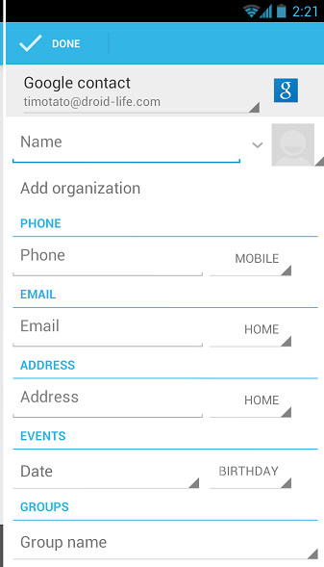
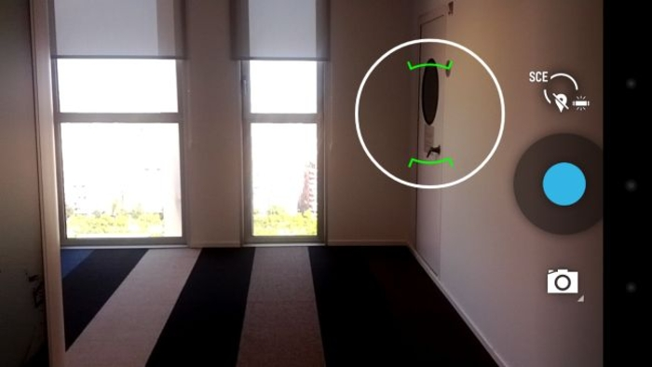
Example
One component can start another component

Slide 16
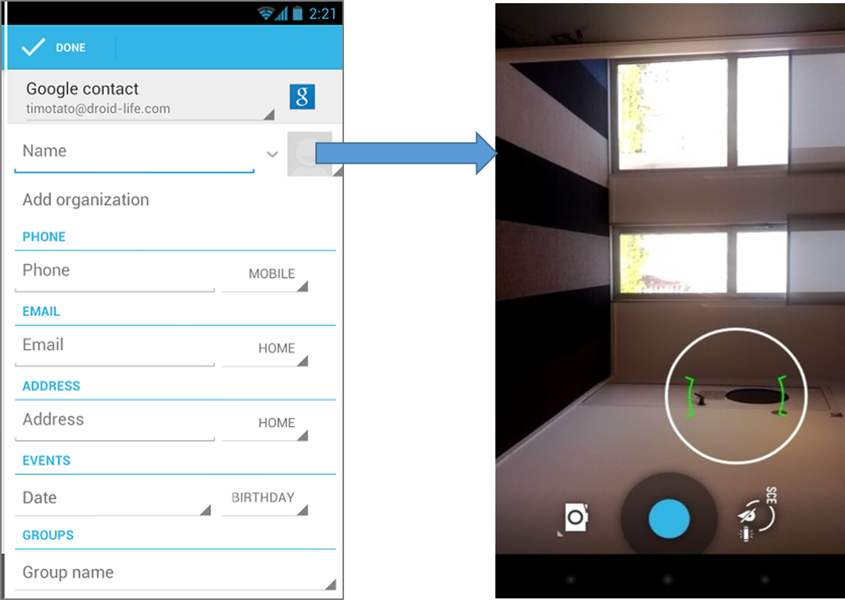
“Intent”: Activating components
Three of the four component types—activities, services, and broadcast receivers—are activated by an asynchronous message called an intent.
Intents bind individual components to each other at runtime.
Intent

Slide 17
“Intent”: Activating Component
You can start an activity (or give it something new to do) by passing an Intent to startActivity() or startActivityForResult() (when you want the activity to return a result).
You can start a service (or give new instructions to an ongoing service) by passing an Intent to startService(). Or you can bind to the service by passing an Intent to bindService().
You can initiate a broadcast by passing an Intent to methods like sendBroadcast(), sendOrderedBroadcast(), or sendStickyBroadcast().
You can perform a query to a content provider by calling query() on a ContentResolver.

Slide 18
Explicit Intents
Explicit – using the component’s class name.
Activity1
Intent x = new Intent(this, Activity2.class);
startActivity(x);
Activity2

Slide 19
Explicit Intent Example – with data
We want to switch to an Activity and pass some data to it.
Activity1
Intent X = new Intent(this, Activity2.class);
X.setData(“some Uri”);
startActivity(X);
Activity2
To access the data in the other Activity:
“getIntent().getData()”

Slide 20
Try this at home
We want to pass strings between Activities:
Create Activity1 (add a button)
Create Activity2 (add a textview)
Send Intent from Activity1 to Activity2
Send Intent with Data

Slide 21




Explicit Intent vs. Implicit Intent
Mr. Thor, can I have your hammer?
Who can share a hammer, please?
me
I need HAMMER
Android OS

Slide 22
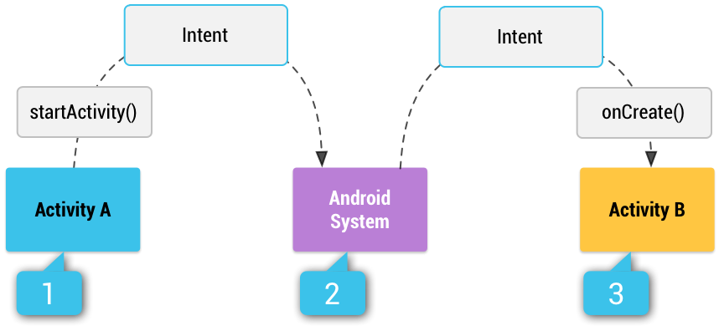
Implicit Intents
Implicit – using some reserved keywords.
You provide type of action to be performed
You can provide data to be used
Multiple matching Activities may exist.

Slide 23
Implicit Intent Example
We want to VIEW a webpage in a browser:
Intent w = new Intent(
Intent.ACTION_VIEW, Uri.parse(“http://www.unc.edu”)
);

Slide 24
Another Implicit Intent Example
We want to VIEW a location on a map:
Intent w = new Intent(
Intent.ACTION_VIEW,
Uri.parse(“geo:35.909715, -79.052779?Z=14”)
);

Slide 25
What if no one to receive my Intent?
Your App will crash!
To get a list of matching Apps:
To verify that the Intent will resolve to an Activity:
getPackageManager().queryIntentActivities(
your_intent,
PackageManager.MATCH_DEFAULT_ONLY
);
X.resolveActivity(getPackageManager()) != null

Slide 26
Getting Results Back
We want an Activity to do something and return the result back to us.
Step1:
startActivityForResult(intent_object, SOME_REQ_CODE);
Step2:
@Override
protected void onActivityResult (int requestCode, int resultCode, Intent data)
{
}

Slide 27
Example: Implicit Intent with Camera
Intent w = new Intent(MediaStore.ACTION_IMAGE_CAPTURE);
startActivity(w);
Just uses the camera. Returns no photos.

Slide 28
Getting the Image Back
Intent w = new Intent(MediaStore.ACTION_IMAGE_CAPTURE);
startActivityForResult(w, 1);
@Override
protected void onActivityResult(int requestCode, int resultCode, Intent x)
{
//if (requestCode == 1 && resultCode == RESULT_OK)
{
Bundle extras = x.getExtras();
Bitmap imageBitmap = (Bitmap) extras.get("data");
img = (ImageView) findViewById(R.id.imageView);
img.setImageBitmap(imageBitmap);
}
}

Slide 29
How to receive an Intent?
Suppose, your App can send or share a text.
Other
Activity
ACTION_SEND
Your
Activity
Plain text
<intent-filter>
<action android:name="android.intent.action.SEND"/> <category android:name="android.intent.category.DEFAULT"/> <data android:mimeType="text/plain"/>
</intent-filter>
You must include the CATEGORY_DEFAULT to receive implicit intents.

Slide 30
How to receive an Intent?
You specify <intent-filter> in your manifest.
Other
Activity
ACTION_MAIN
Your
Activity
LAUNCHER
<activity android:name="MainActivity"> <!-- This activity is the main entry, should appear in app launcher --> <intent-filter> <action android:name="android.intent.action.MAIN" /> <category android:name="android.intent.category.LAUNCHER" /> </intent-filter> </activity>

Slide 31
Practice
Let us try the camera example (implicit intent)

Slide 32
References (study these)
http://source.android.com/source/index.html
https://source.android.com/devices/architecture
http://developer.android.com/guide/components/fundamentals.html
http://developer.android.com/training/basics/intents/sending.html
http://developer.android.com/guide/components/intents-filters.html
http://developer.android.com/training/camera/photobasics.html
https://android.jlelse.eu/closer-look-at-android-runtime-dvm-vs-art-1dc5240c3924
https://events.linuxfoundation.org/images/stories/slides/abs2013_gargentas.pdf

